Slide 1
The Role of Affective Computing in Computer Games
Dr. Saeid Pourroostaei Ardakani
Faculty of Psychology and Educational Science
Allameh Tabataba’i University
Autumn 2016

Slide 2
Outline
Introduction to Affective Computing
Affective signals
Affective functions
Affection recognition
Affective games
Our research

Slide 3
Affective Computing
Affective Computing is a field of study based on how to create systems and devices that are able to recognize, interpret and simulate human emotions.
This was developed by Rosalind Picard (1995) from MIT as a tool to improve the interface man-machine by including affective connotations. All this to improve the computer’s performance and user’s productivity as well.

Slide 4
Interdisciplinary of Affective Computing
Computer Science: This is the science that involves the study of human emotions and reactions.
Electrical Engineering: It is a field of engineering, which allows us to develop digital models which deals with the collection of data from human, making use of sensors and smart devices.
Psychology: This is the science that involves the study of human emotions and reactions.
Biology: This science studies human organs and how we can detect emotions from them (e.g. Heart Rate)

Slide 5
Affective Signal (1/2)
An affective signal is the response to the different situations we experiment in our environment and they play an important role in the decision-making process and solving problems as well.
This is of relatively short duration, and will fall below a level of perceptibility unless it is re-activated [Picard, 1997].
An affective signal has two components [Damasio, 1994]:
  Mental component (cognitive)
  Physical component (body)

Slide 6
Affective Signal (2/2)
Affective Signals (EMOTIONS)
Occurred as a direct consequence of encountering some kind of event.
Cause a detectable physical response in the body:
Fear a heightened heartbeat, increased “flinch” response, and increased and muscle tension.
Anger based on sensation, seems indistinguishable from fear.
Happiness is often felt as an expansive or swelling feeling in the chest and the sensation of lightness or buoyancy,
Sadness feeling of tightness in the throat and eyes, and relaxation in the arms and legs.
Shame can be felt as heat in the upper chest and face.
Desire can be accompanied by a dry throat, heavy breathing, and increased heart rate.
PRIMARY
SECONDARY
Can be caused directly by primary emotions or come from a cognitive process
ex. Embarrassment

Slide 7
Properties of Affective Signals
Temperament and personality influences (influence emotion activation and response)
Non-linearity (emotional system is non-linear)
Time-invariance (independent of time for certain durations)
Activation (Not all inputs can activate an emotion)
Saturation (response will no longer increase)
Cognitive and physical feedback
Background mood

Slide 8
Where the Affective Signals come from?
Speech
Facial expression
Body movement and gesture
Bio-feedback
Neuro-feedback
Social parameters (from analysis of social media)

Slide 9
Affective Functions
For a Computer to be Affective should have at least one of the following functions:
  Recognizing Emotion.
  Expressing Emotion.
  Having Emotion.

Slide 10
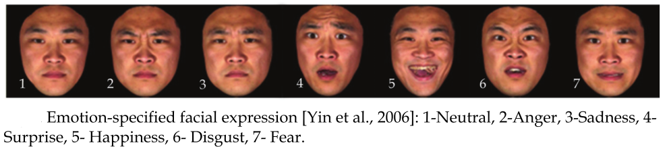
  Functions- Recognizing Emotion.

Slide 11
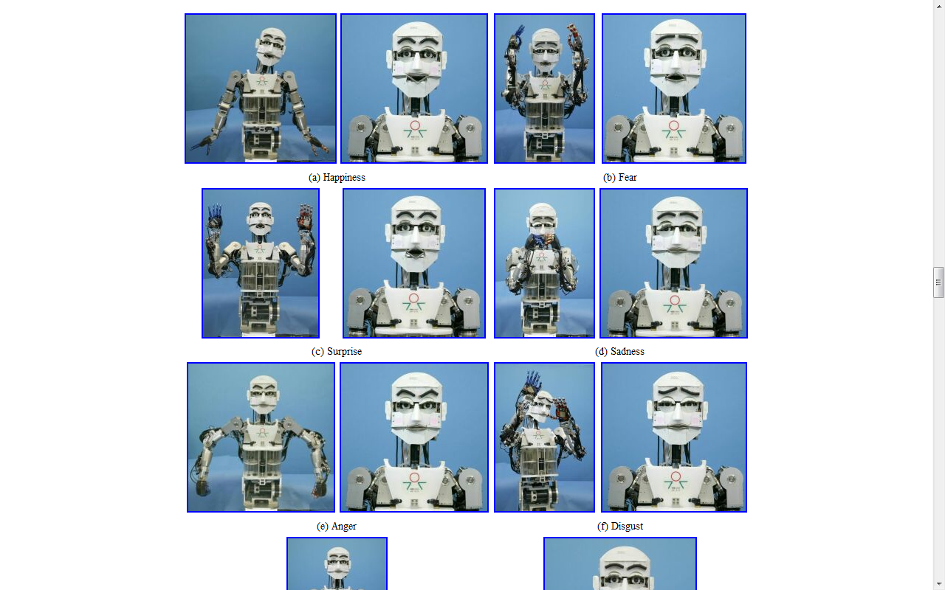
  Functions- Expressing Emotion.

Slide 12
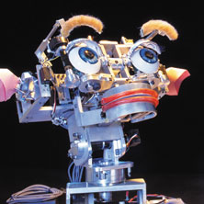

  Expressing Emotion (application example)
Expressing Emotional
Evolution over the years
Figure : MS Office Assistant
Figure : Kismet Robot

Slide 13


  Functions- Having Emotion
  Affective Computing
    Vs
  Artificial Intelligence

Slide 14
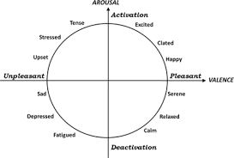
How to model Affective Signals?
circumplex model (Russell, 1980)

Slide 15
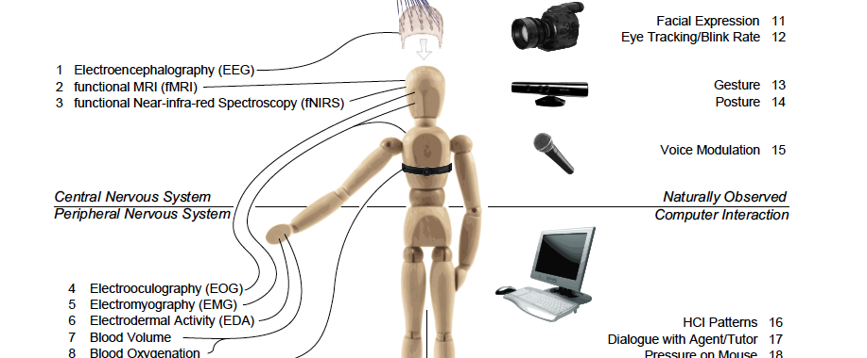
Affection Recognition

Slide 16


Affection Recognition Method
Speech Recognition Architecture
Accuracy rates from speech are somewhat lower (35%) than facial expressions for the basic emotions .
    Sadness, anger, and fear are the emotions that are best recognized through voice, while disgust is the worst.
Speech Signal
Pre-processing
Feature Extraction
Classification
Audio recordings collected in call centers and, meetings, Wizard of Oz scenarios interviews and other dialogue systems
Classified Result

Slide 17
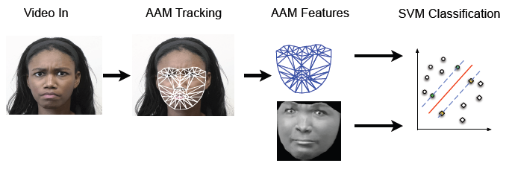
Affection Recognition Method
Facial Expression

Slide 18
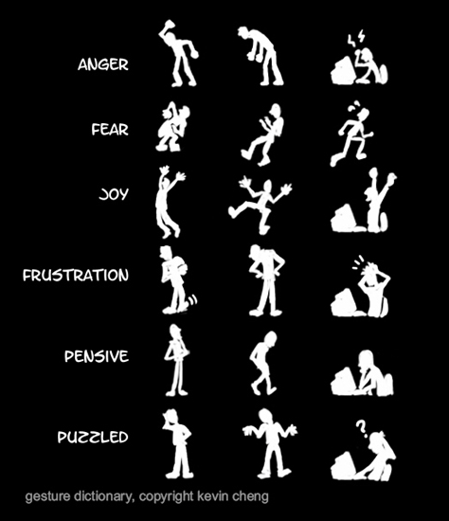
Affection Recognition Method
Gesture / Body Motion
Pantic et al.’s survey shows that combination of face and gesture is 35% more accurate than facial expression alone.

Slide 19
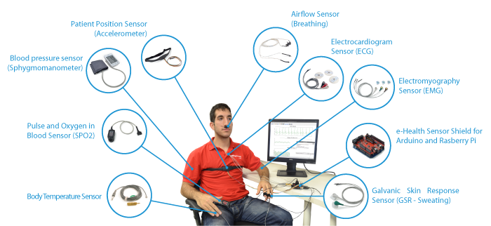
Affection Recognition Method
Bio-feedback

Slide 20
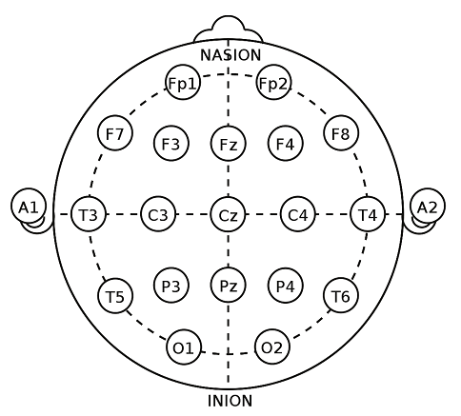
Affection Recognition Method
Neuro-feedback (1/2)

Slide 21
Affection Recognition Method
Neuro-feedback (2/2)
α waves (8–13 Hz): are observed during relaxation, especially with closed eyes;
β waves (14–30 Hz): are observed during mental or physical workload;
γ waves (around 40 Hz): are observed as a rhythmic activity that occurs in response to sensory stimuli(auditory clicks or light flashes);
θ waves (4–7 Hz): are observed during states of displeasure, pleasure and drowsiness in young adults.

Slide 22
Difficulties in Automatic Emotion Classification
We don’t know what to measure.
Emotions experienced by the subject may not correspond well to the stimuli.
Different subjects may react with different emotions to the same stimulus.
The presentation of emotion will differ between subjects and also at different time moments for the same Subject.
Emotion is not clear-cut and measurable, therefore there cannot be “ground truth” data.
There is no agreed protocol for stimulating and measuring emotion.
There is no agreed protocol for testing emotion classification systems.

Slide 23
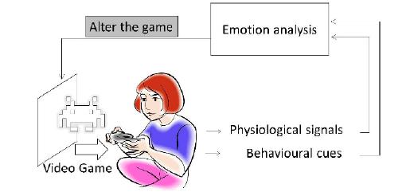
Affective Games

Slide 24
What do it does?
The ability to generate game content dynamically with respect to the affective state of the player.
The ability to communicate the affective state of the game player to third parties.
The adoption of new game mechanics based on the affective state of the player.

Slide 25
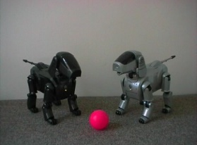

Companion Robots
Aibo (Sony, Japan)
Entertainment robot
I-Cat (Philips, NL)
Robot assistant for elderly people
Paro (Wada et al, Japan)
Robot companion for elderly
Huggable (MIT, USA)
Robot companion for elderly

Slide 26
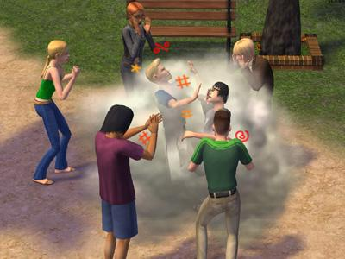
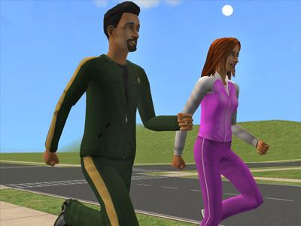

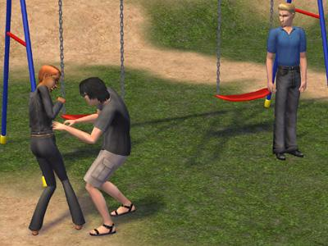
SIMS 2 (Electronic Arts)
Entertainment: emotions are used to provide entertainment value.

Slide 27
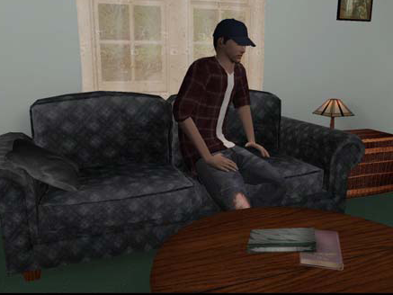
Virtual Training and Virtual Therapy
Therapist skill training using virtual characters (Kenny et al, left)

Slide 28
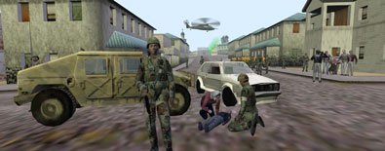
Mission Rehearsal Exercise

Slide 29
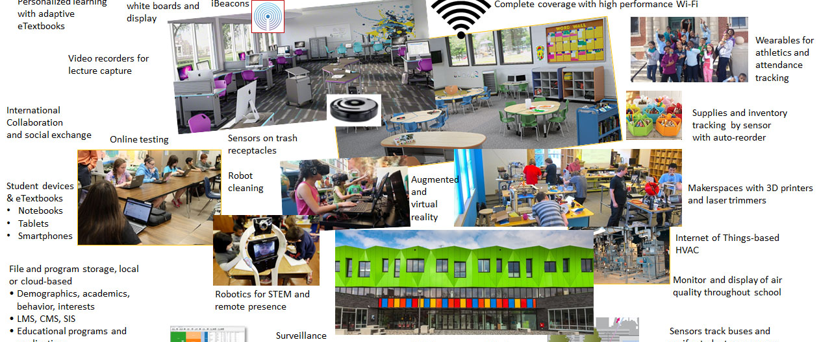
Our Research- Intelligent Education

Slide 30
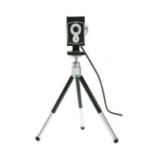



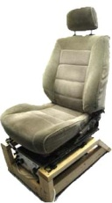
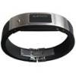
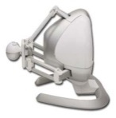
GamePlay
Hardware Calibration Manager
Face Analysis
The Game GUI
The Game Story
The Game Mechanics
The Game …….
Voice
Analysis
Game Controller
Gesture
Analysis
The Game Engine (Decision Support)
Bio
Analysis
Multimodal Affect Input
Adjustments
Game System Architecture

Slide 31
References
^{[1]} Panrong Yin, Linye Zhao, Lexing Huang and Jianhua Tao, “Expressive Face Animation Synthesis based on Dynamic Mapping Method” Published at National Laborotary of Pattern Recognition , Springer-Verlag Berlin Heidelberg 2011.
^{[2]} Site : http://www. affect.media.mit.edu
^{[3]} DAVID BENYON 2010, Designing Interactive Systems- A Comprehensive guide to HCI and interaction design ,Addison Wesley-Second Edition
^{[4]} Site : http://www.agent-dysl.eu
^{[5]} DR. KOSTAS KARPOUZIS, “Technology Potential : Affective Computing”, Image, video and multimedia systems lab, National Technical University of Athens.
^{[6]} Site : https://github.com/lfac-pt/Spatiotemporal-Emotional-Mapper-for-Social-Systems
^{[7]} ZHIHONG ZENG, Member, IEEE Computer Society, MAJA PANTIC, Senior Member, IEEE, GLENN I. ROISMAN & THOMAS S. HUANG, Fellow, IEEE, “A Survey of Affect Recognition Methods: Audio,Visual, and Spontaneous Expressions” .

